Slide 1
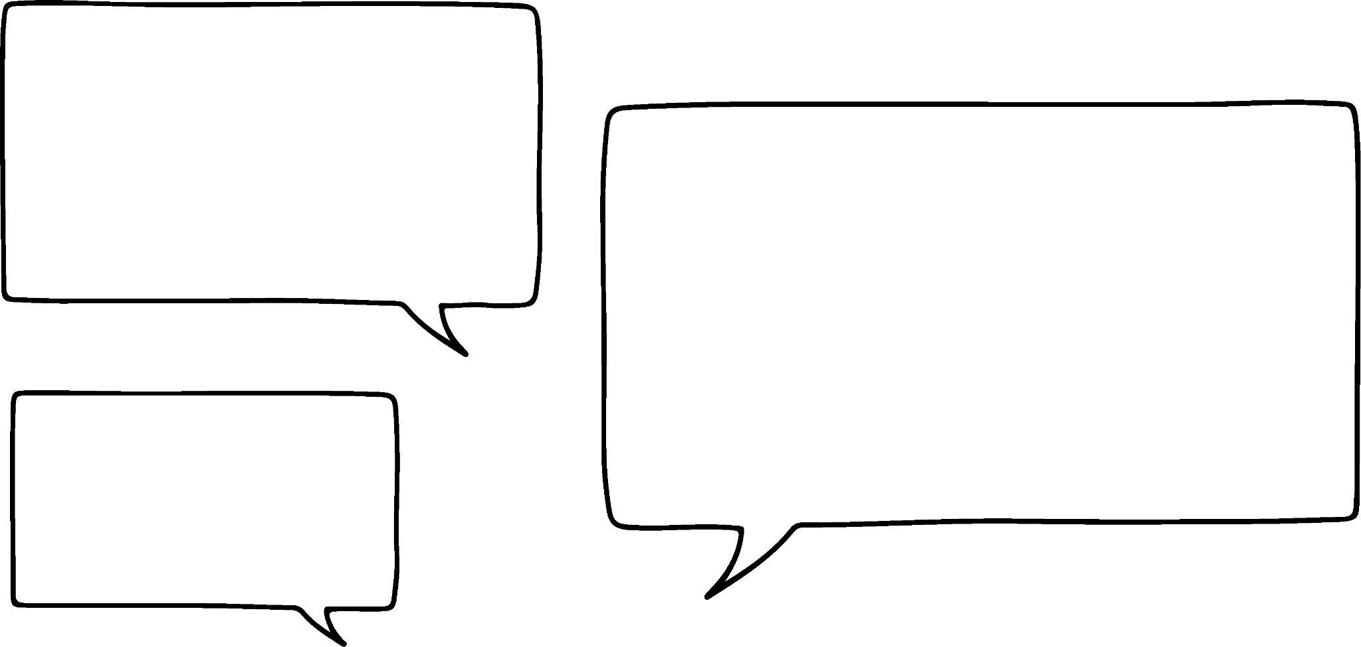


Expressing an arithmetic sequence
Task A: The position of a term in a sequence
1) Match the term number (n) to the term values (T). One has been done for you.
a)
b)
Term number (n) | 1 | 2 | 3 | 4 | 5
Term value (T) | 2 | 5 | 8 | 11 | 14
Term number (n) | 1 | 2 | 3 | 4 | 5
Term value (T) | 5 | 4 | 3 | 2 | 1
n = 1
T = 14
n = 1
T = 1
n = 2
T = 2
n = 2
T = 4
n = 3
T = 2
n = 3
T = 8
n = 4
T = 3
n = 5
T = 5
n = 5
T = 5
2) Andeep and Jacob are looking at an arithmetic sequence.
Term number (n) | 1 | 2 | 3 | 4 | 5
Term value (T) | 45 | 40 | 35 | 30 | 25
I see the pattern!
When n = 0 the term is 50
I agree! Next would be
when n = −1
The term will be 55
Write a sentence explaining why Andeep and Jacob are wrong.
You might have written:
There is no zero term, or −1 term in this sequence.
The first term 45, where n = 1, is the first number in this sequence. There is nothing before it.

Slide 2

Expressing an arithmetic sequence
Task B: The general term of a sequence
1) Sam spots a general rule for this sequence.
,
,
, …
Pattern number | 1 | 2 | 3 | Pattern number
Squares | 4 | 7 | 10 | Pattern number × 3 + 1
Whilst their general rule works, how would you improve upon it?
You might have said, use n to represent the n^{th} term thus writing the rule more concisely.
Pattern number (n) | 1 | 2 | 3 | n
Squares | 4 | 7 | 10 | n × 3 + 1
2) Fill in the table for this sequence and write a general rule each row.
,
,
,
, …
Pattern number (n) | 1 | 2 | 3 | 4 | 5 | 25 | 50 | 100 | n
Shaded squares | 2 | 4 | 6 | 8 | 10 | 50 | 100 | 200 | n × 2
Total squares | 4 | 8 | 12 | 16 | 20 | 100 | 200 | 400 | n × 4
Perimeter | 10 | 12 | 14 | 16 | 18 | 58 | 108 | 208 | n × 2 + 8
Mathematics in Education and Industry
v2.2

